Slide 1

RISS Officer Safety Website

Slide 2

Stats from the National Law Enforcement Officers Memorial Fund
More than 19,000 U.S. law enforcement officers have lost their lives in the line of duty
It is estimated that on average, one officer is killed every 53 hours

Slide 3
Law Enforcement Officer Safety Initiative
U.S. Attorney General Eric Holder announced the formation of the Initiative in March 2011
Made officer safety a top priority
The RISS Officer Safety Website and RISSafe™ were named as components of the Initiative

Slide 4

Developed in collaboration with the U.S. Dept. of Justice, Bureau of Justice Assistance VALOR Program
Dedicated to providing law enforcement and criminal justice users with timely officer safety information
Provides a secure means to exchange and share officer safety-related information among agencies

Slide 5
What is available on the
RISS Officer Safety Website?
Officer safety awareness
Officer safety-related videos
Officer safety training information
Armed and dangerous subjects
Concealment methods
Narcotics awareness information
Gang awareness information
Domestic terrorism information
Border security information
Officer Down Memorial
Today’s Roll Call

Slide 6
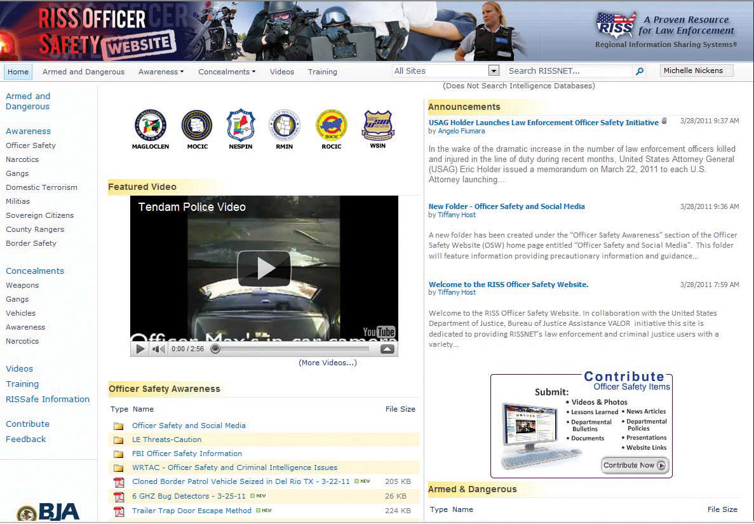

Slide 7
Other Features of the Website
Training calendar that lists training event information
Video library of officer safety-related videos from a variety of sources
Allows officers to contribute information and provide feedback with comments and suggestions for how the site can be enhanced

Slide 8
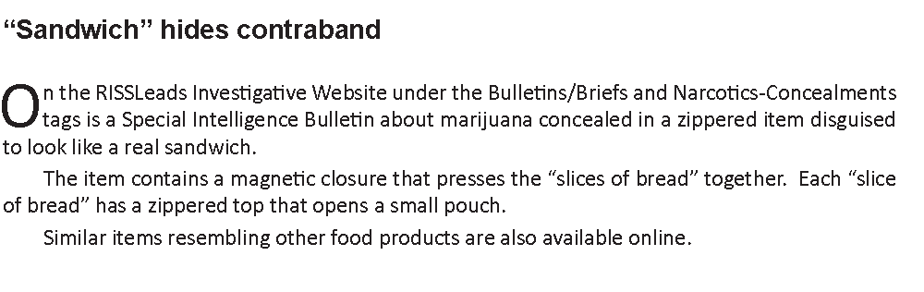
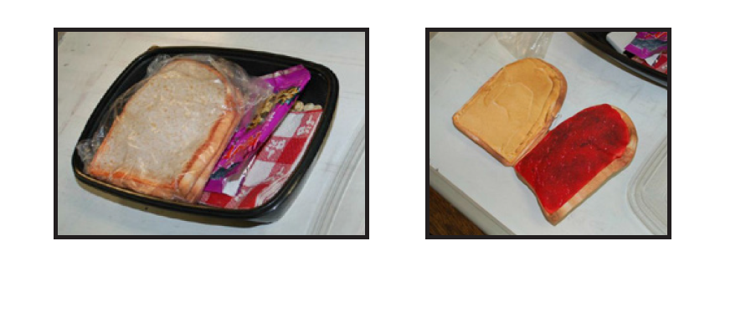
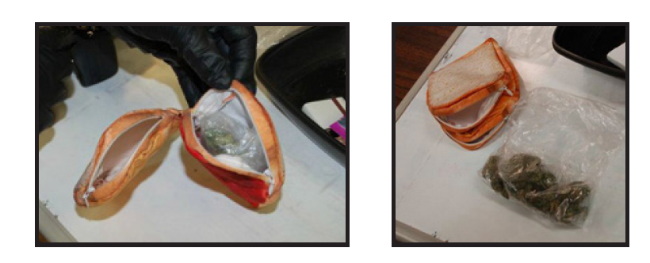

Slide 9
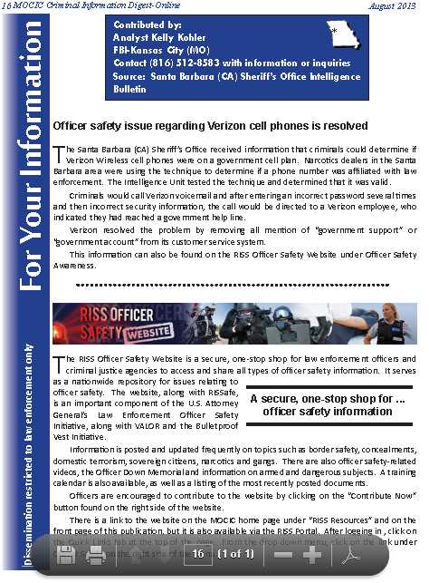

Slide 10
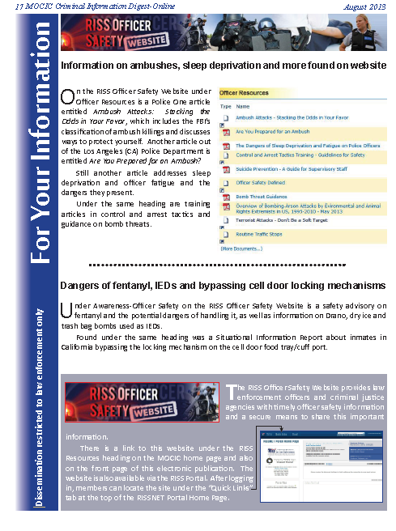

Slide 11
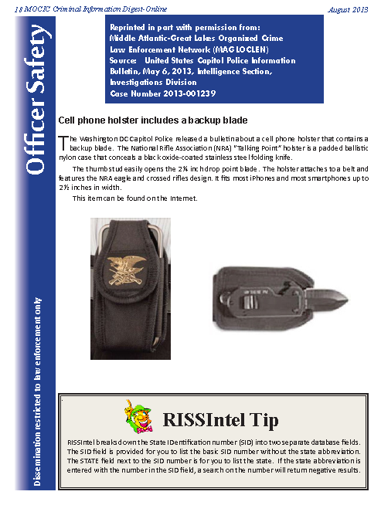

Slide 12
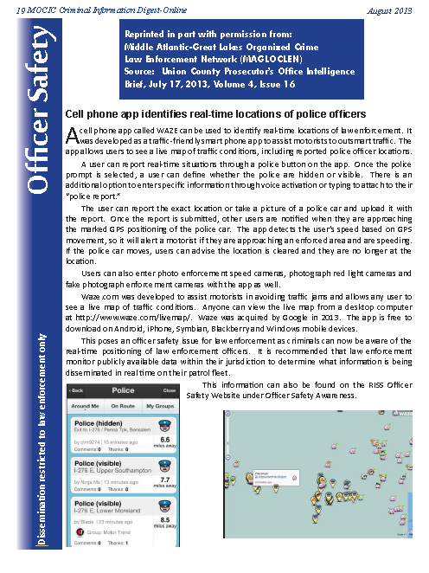

Slide 13
Visit the site frequently to access new information
Access to the RISS Officer Safety Website is available to all law enforcement officers through the use of their RISSNET user accounts
(www.riss.net)
Officers can also access the site by registering at the VALOR website
(www.valorforblue.org)

Slide 14
In the last 12 months ten (10) officers in the MOCIC region have lost their lives in the line of duty
The RISS Officer Safety Website was designed to reduce the number of these deaths
MOCIC encourages all officers to use this valuable tool

Slide 15
As you leave take time to talk with the MOCIC staff about all of the valuable services and resources that are available to assist you.

